Slide 1
Digital Program
Suggestions on how to craft better emails
2020-04-28

Slide 2
Purpose
The suggestions in this PowerPoint are designed to address specific concerns the Digital Program team have encounter in email communications. These are just suggestions that the team has identified and is a recommendation for the Digital Program team to follow. This is not something that is mandated.
For CWB email policy please visit INFOserver (http://infoserver.cwb.local/home.aspx)

Slide 3
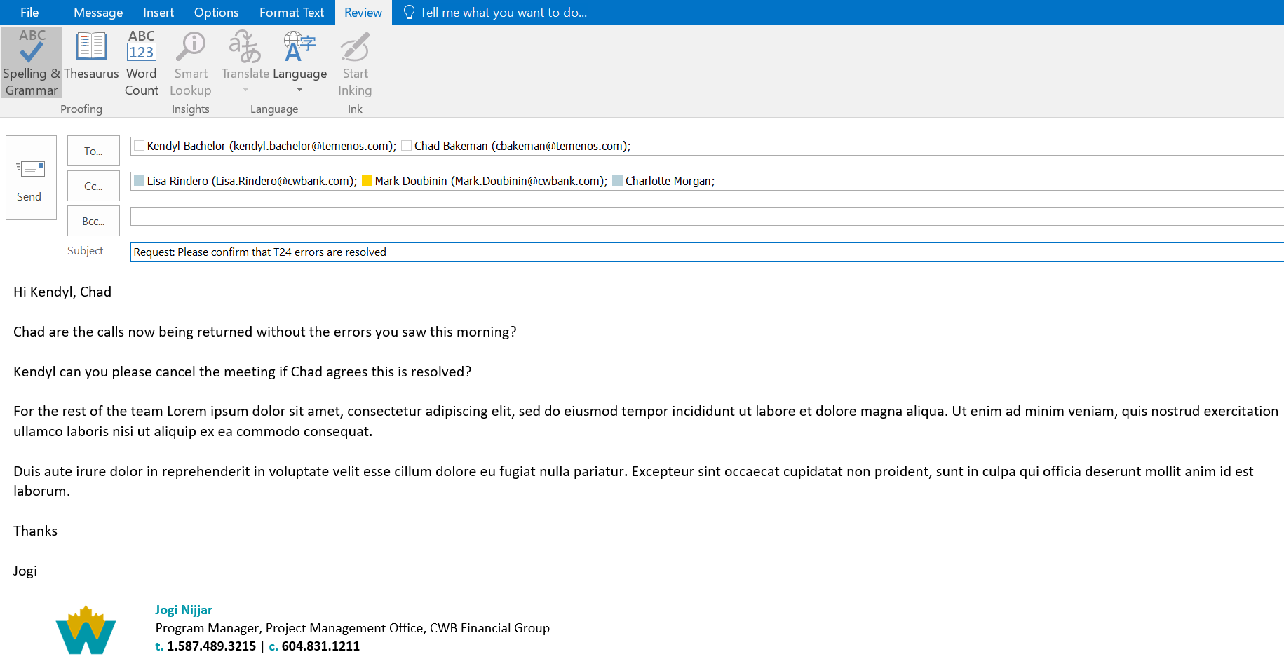
Elements of a better email
Subject line with taxonomy and accurate call to action
People who need to action/answer are
1) To: field
2) top of the email salutation line
People who are informed are in CC: field
Actions/requests at the top of the email, called out by name.
Contact information in the email signature

Slide 4
Possible Subject Line starters
Questions: something quick the recipient can respond, rarely requires a lot of work/long reply
Request: work is required but not necessarily something that recipient was aware of or was planned for
Action: planned work/agreed upon work that receipt needs to follow up
Blocked: raising a flag to let recipient know their work is blocked; just judicially
FYI: informational only, no action required by recipient
Update: letting recipient know that something has changed
CRITICAL: all caps CRITICAL, the world is on fire, please drop what you are doing and help out

Slide 5
Final Thoughts
Is that email meant for Mark at CWB or Mark at thirdstream? Sandra or Sandra or Sandra?
make sure you have the right person called out by company and the correct name on the email, invite or on an action
Is that Temenos Avoka or Temenos T24?
make sure you are calling out the right team
By “integration” do you mean Avoka side, T24 side, CWB or BIG or something else?
make sure you are clear when you are referencing technology or packages of work

